Slide 2

Justin Sider
Try This, Catch That, Finally
An Explanation on PowerCLI Error Handling
Chief Information Officer, Belay Technologies

Slide 3






About Me
Blog
Invoke-automation.blog
Twitter(X)/Slack/GitHub
jpsider
VMware Programs
VMUG Advantage
VMUG Board of Directors
vExpert x10
VMware Code Coach 20-25

Slide 4
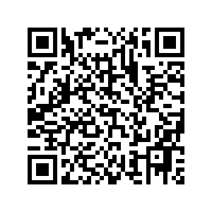
Agenda
Terminating Errors
Non-Terminating Errors
ErrorAction Thingys
Try & Catch
Finally
PowerCLI Demo!
API Demo!
Questions?
Link to Code!

Slide 5
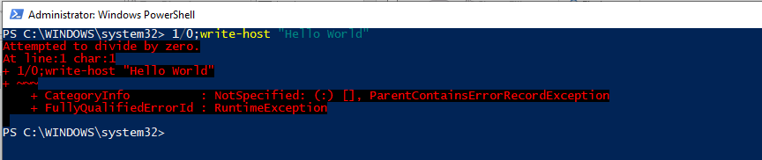
Terminating Errors
It stops or halts the execution of the script so that the commands in the next lines cannot be executed.

Slide 6
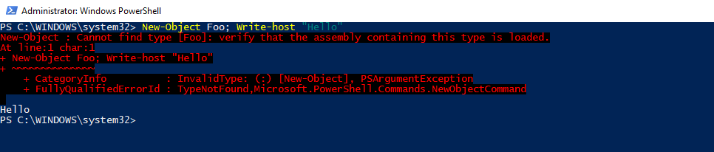
Non-Terminating Errors
Are generally generated by internal cmdlets and automatically handled by them, but the error does not terminate the execution of the pipeline.

Slide 7
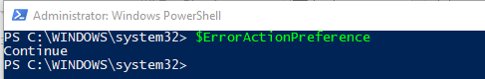
ErrorAction Thingys
$ErrorActionPreference
Only responds to Non-terminating Errors
Console/Script Specific
-ErrorAction Parameter
Specific to a command
Overrides $ErrorActionPreference
Options
SilentlyContinue, Stop, Continue, Inquire, Ignore, Suspend, Break

Slide 8
Try & Catch
Try {
Run a command
}
Catch {
Capture the problem. Maybe log about it. But it allows you to continue.
}
Note: Catch is REQUIRED with a Try.

Slide 9
Finally (Optional)
Try {
Run a command
}
Catch {
If there is an issue. (still required)
}
Finally {
Will run, no matter what! And can be used to clear resources, variables or files.
}

Slide 10



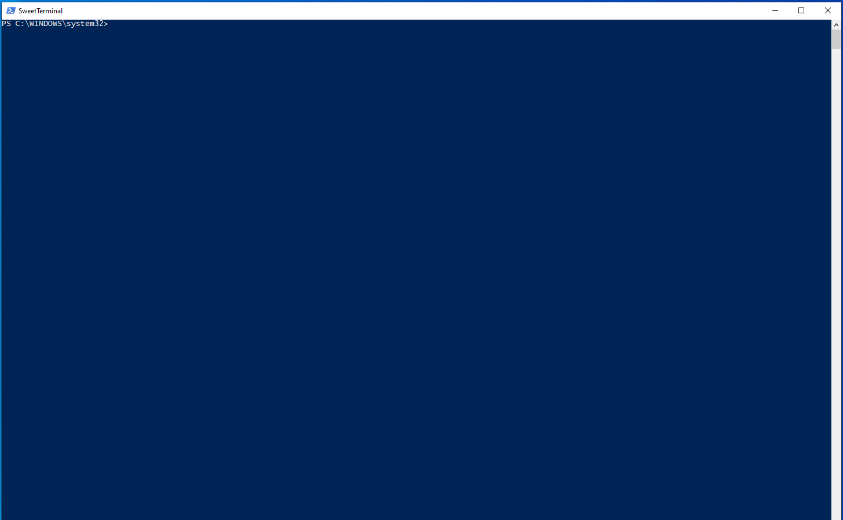

Demo Time !

Slide 11

API Demo

Slide 12
You can do this!

Slide 13
Questions?
Link to Code!

